Slide 1

Jetty 9
Dima Ionut Daniel

Slide 2
Contents
What is Jetty?
History
Jetty 9 new features
Jetty Configuration
Deployment Arhitecture
JMX
SPDY
Handlers
WebSocket API
Jetty Connectors
Jetty Runner
Jetty Logging
Conclusions
Bibliography

Slide 3

What is Jetty?
Jetty is a pure Java HTTP server and Java Servlet container.
Jetty is developed as a free and open source project as part of Eclipse Foundation.
The web server is used in products like: Apache ActiveMQ, Alfresco, Apache Geronimo, Apache maven, Google App Engine, FUSE, Twitter, Zimbra.

Slide 4
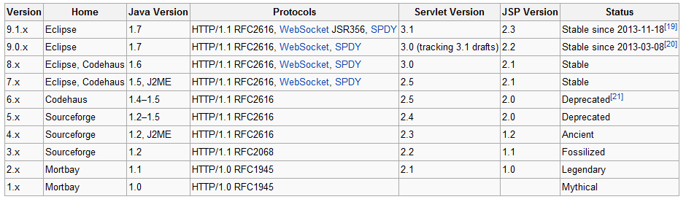
History
Jetty was originally a HTTP server component of Mort Bay Server.
Jetty was originally called IssueTracker (its original application) and then MBServler (Mort Bay SERVLet servER).

Slide 5
Jetty 9 new features
native support for modern protocols like: WebSocket, SPDY
improves performance
supports Servlet 3.1 and JSR-356 specifications.
centralized documentation

Slide 6
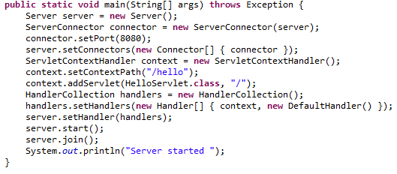
Jetty Configuration
Jetty can be started using the standalon distribution or embedded.
Jetty embedded can be started using Jetty XML configuration or using POJO clases.
Jetty is also an Inversion of Control(IoC) framework.
Jetty can be integrated with Spring .
Because the main Jetty configuration is done by IoC, the Jetty API documentation is the ultimate configuration reference.

Slide 7
Jetty Configuration (cont.)
The Server instance is the central object of Jetty server and contains following configuration
ThreadPool: configuration for threading.
Handlers: used for incoming HTTP requests.
Server attributes: generic attribute map of attributes used by Server.
Connectors: collection of connectors that receive connections for HTTP and other protocols that Jetty supports.
Services: additional service objects.

Slide 8
Jetty Configuration (cont.)
A Jetty Server connector is a network endpoint that accepts connections and produces requessts for the Jetty Handlers.
Prior to Jetty 9, the type of the connector reflected both the protocol supported (HTTP, HTTPS, AJP, SPDY), and the nature of the implementation (NIO or BIO).
From Jetty 9 onwards there is only one prime Connector type (ServerConnector), which is NIO based and uses Connection Factories to handle one or more protocols.

Slide 9
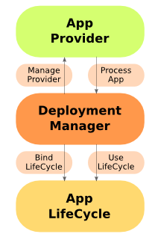
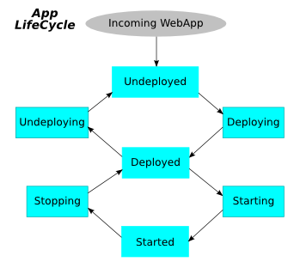
Deployment Arhitecture
Jetty is built around an extensible Deployment Manager architecture complete with formal LifeCycle for Web Applications.
For Jetty to serve content (static or dynamic), we need to create a ContextHandler and add it to Jetty in the appropriate place
A pluggable DeploymentManager exists in Jetty 7 and later to make this process easier.
The DeploymentManager is the heart of the typical webapp deployment mechanism.
An AppProvider identifies the App and then provides it to the DeploymentManager;the main AppProvider with the Jetty distribution is the WebAppProvider.

Slide 10
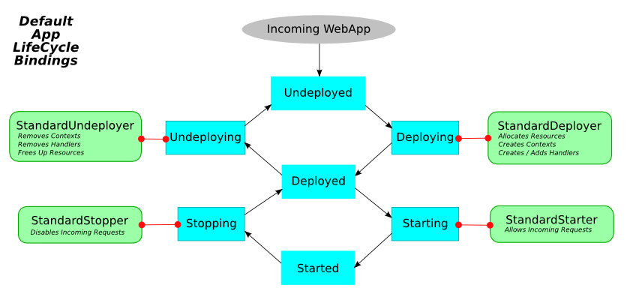
Deployment Arhitecture (cont.)
A set of default AppLifeCycle.Bindings defines standard behavior, and handles deploying, starting, stopping, and undeploying applications.
There are four default bindings:
StandardDeployer: Deploys the ContextHandler into Jetty in the appropriate place.
StandardStarter: Sets the ContextHandler to started and start accepting incoming requests.
StandardStopper: Stops the ContextHandler and stops accepting incoming requests.
StandardUndeployer: Removes the ContextHandler from Jetty.

Slide 11
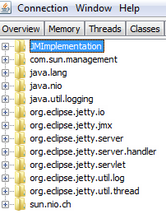

JMX
The JMX API provides remote access.
The MBeanContainer implementation of the Container.Listener interface coordinates creation of the MBeans.
JMX is enabled by default in the jettz 9 distribution.
Configuring Jetty JMX integration differs from standalone and embedded Jetty.

Slide 12
SPDY
SPDY is an open networking protocol developed primarily at Google for transporting web content.
SPDY goals:
reducing web page load latency and improving web security
achieves reduced latency through compression, multiplexing, and prioritization
Implementations of SPDY exist in Chromium, Mozilla Firefox, Opera, Amazon Silk, and Internet Explorer.
SPDY requires the use of SSL/TLS (with TLS extension NPN), and does not support operation over plain HTTP
SPDY does not replace HTTP; it modifies the way HTTP requests and responses are sent over the wire.
SPDY is a versioned protocol.

Slide 13
SPDY (cont.)
Jetty supports both a client and a server implementation for the SPDY protocol.
To provide the best support possible for SPDY, the Jetty project also provides an implementation for NPN.
Both the SPDY and the NPN implementations require OpenJDK 1.7 or greater.
A server deployed over TLS normally advertises the SPDY protocol via the TLS Extension Next Protocol Negotiation (NPN).
Jetty's SPDY modules:
spdy-core: contains the SPDY API and a partial implementation.
spdy-jetty: binds the spdy-core module to Jetty's NIO framework to provide asynchronous socket I/O.
spdy-jetty-http: http module that provides a server-side layering of HTTP over SPDY.
spdy-jetty-http-webapp: webapp module–provides a demo application for the a spdy-jetty-http module.

Slide 14
Handlers
Jetty contains a bundle of predefined handlers:
ResourceHandler – handles static content.
ShutdownHandler - shuts the server down on a valid request.
ErrorHandler - used to report errors from servlet contexts and webapp context.
DebugHandler - useful to debug incoming traffic.
IPAccessHandler - control is provided by white/black lists that include both internet addresses and URIs
StatisticsHandler - used to collect request statistics.
MovedContextHandler - used to relocate or redirect a context that has changed context path.

Slide 15
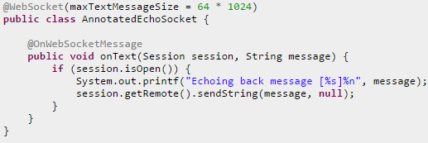
WebSocket API
Jetty provides it’s own WebSocket API(event driven) for client and server.
WebSocket Events:
On connect: indication that the WebSocket is now open.
On close: indication that the WebSocket is closed.
On error: In case of error occurred the WebSocket will be notified via event handler.
On message: indication that a complete message has been received.
WebSocket annotations: @WebSocket, @OnWebSocketMessage, @OnWebSocketClose, @OnWebSocketError, @OnWebSocketFrame.

Slide 16
Jetty Connectors
Jetty accepts network connections using connectors, for various protocols.
The configuration of an connectors involves the following:
Network parameters.
Services that connector uses.
Connection factories that instantiate and configure the protocol for the accepted connection.
The standard Jetty distribution contains sample XML files for creating and configuring the connectors.
Sample protocols: http, https, ssl, http2, spdy, alpn, npn.
Jetty primarily uses a single connector type called ServerConnector.

Slide 17
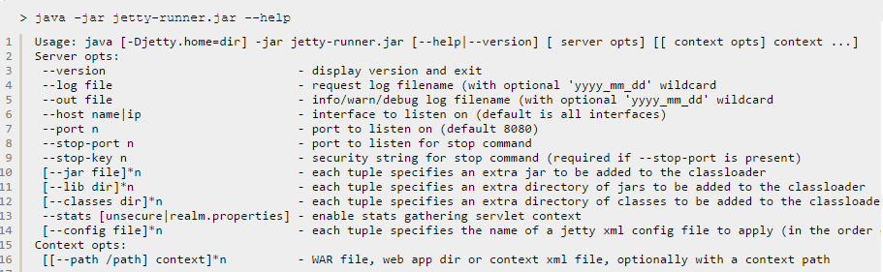
Jetty Runner
Jetty-runner is used to run webapp directly from the command line using a single jar and as much default configuration as possible.
Jetty-runner can deploy single or multiple contexts.
Example → java –jar jetty-runner.jar –port 9090 simple.war

Slide 18
Jetty Logging
Jetty provides logging via org.eclipse.jetty.util.log.Logger layer.
Jetty logging has a slightly different set of levels that uses internally:
WARN → events to inform and log but not fatal.
INFO → informational events
DEBUG → debugging events
IGNORE → exception events that can be safely ignore
Jetty first tries to find jetty-logging.properties file and then tries to get system properties.
Jetty tries to determine log implementation.
If no logger implementation is specifies, default log will be directed to org.eclipse.jetty.util.log.StdErrLog.

Slide 19
Conclusions
Jetty can be use as standalone or can be embedded.
Jetty is documented and it’s easy to use.
Jetty is stable and can be configured programatically or using external XML descriptor files.
Jetty can serve 10K requests over 1 TCP/IP connection and it’s designed also for WebSocket connections.
Jetty is very extensible and supports lots of protocols.

Slide 20

Bibliography
http://en.wikipedia.org/wiki/Jetty_(web_server)
http://www.eclipse.org/jetty/documentation/current/

